Slide 1
Slide Deck for VSM

Slide 2
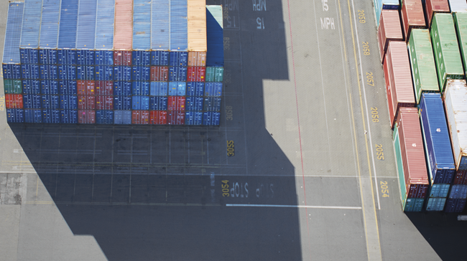
THE MICROSOFT
DevOps Story
Dan Stolts
Chief Technology Strategist- Microsoft
@ITProGuru
dstolts@microsoft.com

Slide 3
Traditional vs modern dev-ops
Category | Traditional | Modern DevOps
Quality of code check-ins | Unknown | Validated through unit tests
Environment Creation/Configuration | Manual | Automated
Deployment Frequency | 1-2 months (or less frequent) | Deploy whenever needed, including several per day
App Deployment Process | Requires meetings and planning | Push-button deployment
Deployment validation | Manual | Automated
Monitoring | Minimal to none | Health and Performance monitoring
Dev and Ops relationship | Blame culture | Culture of trust

Slide 4
Program Highlights
Introductory Meeting [1.5 hours]
Quick review of pipeline: Feedback.. Production -> Planning/Ideation. This review will help us answer the following:
Identify primary tools, processes and perceived weaknesses if any
Define needed participants/roles to be included in VSM (and hack) - includes name, email address, tittle, role (Homework?).
Schedule VSM (Aug 31-Sept 1) & Hack October ????
If time, identify any training desired
VSM – Day 1-2
Around the room intro’s
Short DevOps Training
Whiteboard Value Stream Map
Working Lunch
Plan hack priority - {if needed}
Define Success
Identify expected outcomes
Homework – if needed
Lock hack dates
Training (Docker, VSTS, Azure, Hybrid, whatever) if needed and time permits
Hackfest
Day 1 - Setup Teams; Identify requirements, Identify scribe; Perform Training; Hack rest of day 😊
Day 2- Hack all day ☺ 3pm Team scrums
Day 3-? Hack all day ☺
Last Day
Morning Test process; tweak as needed
Document – outline will be provided; Teams can use to share their success with their leadership
Working Lunch
Afternoon Document; Create follow-up plan (future hacks, deploy in production, work on different part of pipeline, etc)
2:30-3:30pm; 10-15 mins team presentations to all hackers and Q&A from other hack teams
Provide Feedback using Event Feedback URL
Plan Project Phase II
Define Post hack Schedule
Leadership team discussions of projects and priorities
Plan continued hack schedule
4:30pm hack ends

Slide 5






DevOps is the union of people, process, and tools to enable continuous delivery of value of our end uses.
DEV
OPS
1
People
2
Process
3
Tools
Notes:
People = Culture
Fundamental attributes of successful cultures:
Shared mission and incentives: infrastructure as code, apps as services, DevOps/all as teams
You need to consider your hardware as a commodity, (don't give your servers names) , servers are like farm animals, it is just harder if you let theids name them
Build deep instrumentation into services, push complexity up the stack
Rally around agile, shared metrics, CI, service owners on call, etc.
Changing the culture: any change takes time, changing culture is no exception and you can't do it alone, exploit compelling events to change culture: downtimes, cloud adoption, devops buzz
PROCESS Definition and design, compliance, and continuous improvement
PEOPLE Responsibilities, management, skills development, and discipline
Tools and infrastructure

Slide 6
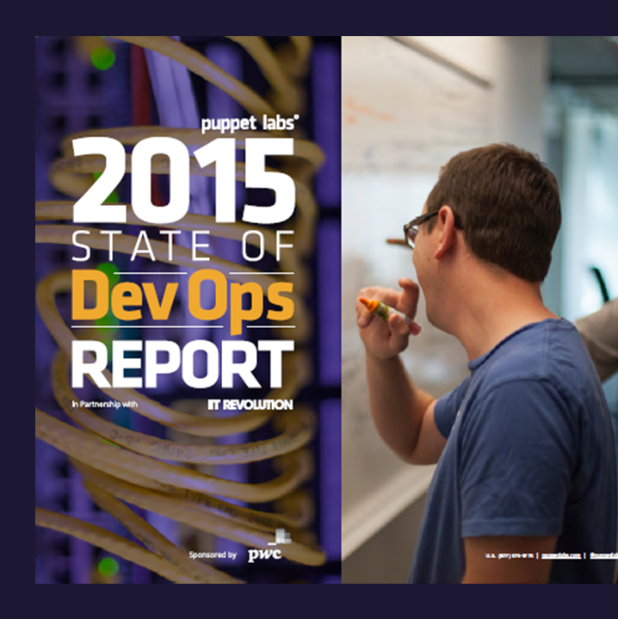
DevOps Benefits
Strong IT Performance is a competitive advantage
Deploy code 30x faster
Firms with high-performing IT organizations were 2x as likely to exceed their profitability, market share, and productivity goals
and with 200x shorter lead time as compared to their lower-performing peers
Have 60x fewer failures
DevOps Practices improve IT performance
and recover from failure 168x faster as compared to their lower-performing peers
Source: https://puppetlabs.com/
Notes:
2014 Report collected in December 2013 had over 9,200 survey respondents across 110 countries with companies of ALL sizes and verticals.
2015 Report had 4,976 respondents with companies of ALL sizes and verticals.

Slide 7
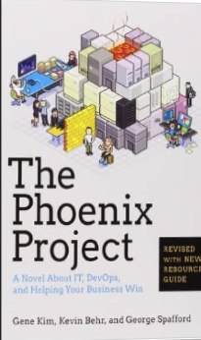
Tip: Must Read Book
Amazon…
The Phoenix Project: A Novel about IT, DevOps, and Helping Your Business Win Paperback
– October 16, 2014
The book is available on Audio Book; you can likely get it for free, if you do not already have an account. If you do not have an Audible Account, you get two free books when signing up for your free account.
This is the BEST IT Book I have ever read.

Slide 8



The Goal of DevOps (aka Gene Kim’s “Three Ways”)
1 way : Shorten the lead time
2 way : Feedback loop
3 way : Experimentation
Development Business
Operations Customer
Notes:
If something is canonical status, it is accepted as having all the qualities that a thing of its kind should have.
正典、標準的な

Slide 9
List of DevOps Practices
Primary
Secondary
Infrastructure as Code (IaC)
Continuous Integration
Automated Testing
Continuous Deployment
Release Management
App Performance Monitoring
Load Testing & Auto-Scale
Availability Monitoring
Change/Configuration Management
Feature Flags
Automated Environment De-Provisioning
Self Service Environments
Automated Recovery (Rollback & Roll-Forward)
Hypothesis Driven Development
Testing in Production
Fault Injection
Usage Monitoring/User Telemetry
http://www.itproguy.com/devops-practices/

Slide 10
THE MICROSOFT
Value Stream Mapping Context

Slide 11
Role of Security in DevOps aka DevSecOps
Incorporate security necessities into every aspect of the business; enable others to automate compliance
Making the business case:
GOVERNANCE
Security
Culture, politics, processes & laws that determine how a company should conduct itself.
Confidentiality
TRUST
Availability
Effect if uncertainty on organizational objectives.
Act of adhering & demonstrating adherence to laws, regulations, corporate policies & procedures.
Integrity
Privacy
COMPLIANCE
RISK
Help build a product that will inspire our customers to become raving fans

Slide 12
Roles and Responsibilities
Security - Incorporate security necessities into every aspect of the business; enable others to automate compliance
Development – Quickly build, deploy & update a product that our customers love; Enable other groups by building what they need to support you.
IS/IT – Build infrastructure as code; enable others by helping to eliminate waste throughout the technology landscape
Management – Enable the teams by giving them flexibility, guidance and support to do what is needed; remove obstacles
Senior Management – Embrace Cultural Change; Drive Transformation in the organization.
Everyone – Help build a product that will inspire our customers to become raving fans
Notes:
Security - Help find a way to incorporate security necessities into every aspect of the business; without getting in the way unnecessarily

Slide 13
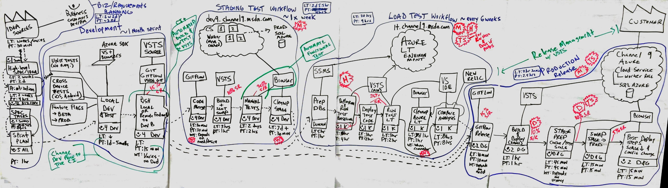
Value Stream Mapping
Analyze and Share “Waste”
Help to shorten the lead time
Value Stream Map の例

Slide 14
Why Value Stream Mapping (VSM)?
«
Aids visualization
Makes “waste” easier to see
Brings a common language that can be understood easily by all levels of the organization
Forms the base to build an implementation plan
Prioritizes improvement efforts (i.e. DevOps Practices)
Provides structured system for deciding where the next improvements should be.
Fosters discussion across the teams within the company
Links information and code flow
A VSM provides a “rich picture” of the process
Notes:
Value Stream Mapping aids visualization by allowing persons to see the entire VSM on a single (11”X17” or A3) piece of paper.
A “rich picture” is a metaphor to explain that as well as the process steps, each aspect of the process is given depth and clarity through the structure of the VSM

Slide 15
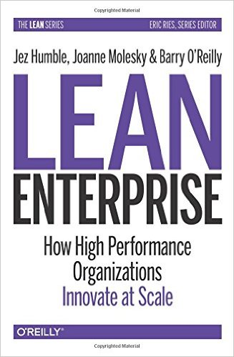
Additional reading
Notes:
This guide will give additional background information on how to implement the VSM and bring a practical way to design and bring improvements.
https://www.amazon.com/Value-Stream-Mapping-Organizational-Transformation/dp/0071828915/ref=sr_1_1?ie=UTF8&qid=1474332193&sr=8-1&keywords=value+stream+mapping
The first three chapters of the VSM book are very helpful to read before you start doing one VSM with a customer.

Slide 16
VSM Ground Rules
No interruptions – 100% focus from all
Tell how it is even if it’s bad, not how you’d like it be
Finger-pointing and blame have no place
No silent objectors
Respectful disagreement is encouraged; it’s not acceptable to be disagreeable
One conversation at a time; avoid talking over each other.
Rank has no privilege
Eliminate “us” versus “them” thinking

Slide 17
VSM Ground Rules (after retrospective)
Eliminate “can’t” and “No, because..” from your vocabulary. Adopt a “Yes, if…” mindset.
Eliminate “this is the way we’ve always done it” thinking.
Ask “why?” “why not” and “what if?”
Be Bold.
VSM Ground Rule Violations:
3 Knocks!

Slide 18
Example New Pipeline
Pipeline: Prod Hotfix 2.0
DevTest
Staging 2 (Prod Level Test)
Production
Pipeline: Version.NEXT (2.2)
Dev – Working environment
Dev Test – More powerful VMs – Integration Environment; smoke test; basic functional testing
Host Test – Demo Environment – Future Version
Pre-Prod – Clean Environment - Performance Testing – Prod Data Update
UAT – Outside testing; customers play with what’s next
Production
Pipeline: #.next
2.x, 3.x, 4.x etc…
Same as Version.Next

Slide 19
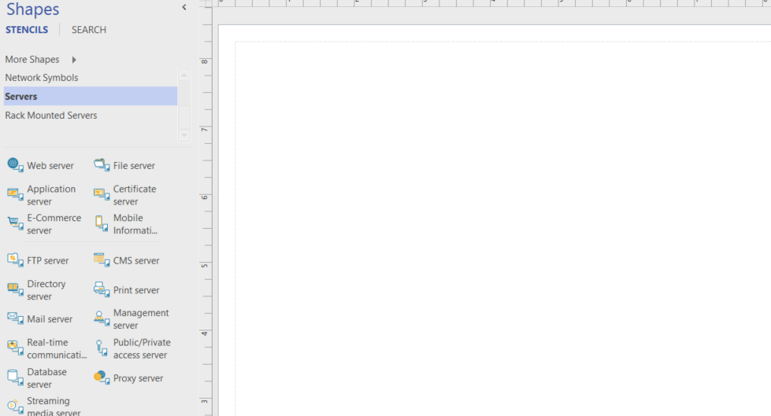
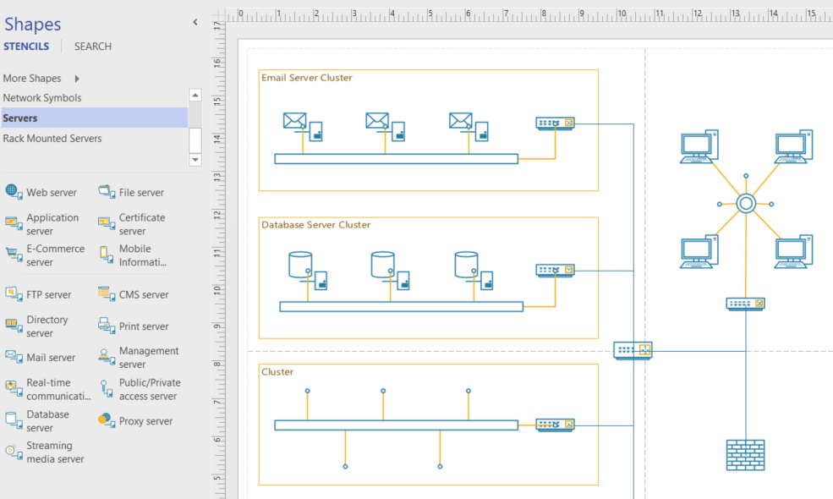
Azure..Like Visio, you start with a blank canvas…
Architect what is possible for your company. Solve Your Business Challenges with the Azure Cloud

Slide 20
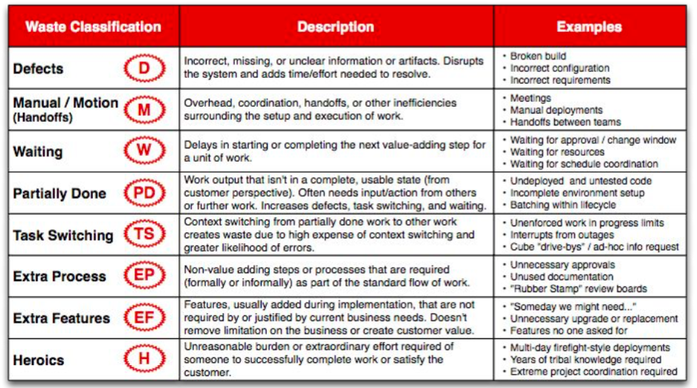
Notes:
Explain in details the definition of couple of the wastes like “Heroic” or “Manual”.
Bring the slide back on the screen during the Waste analysis and recommendations.

